Slide 1

Database Corruption
Advanced Recovery Techniques
Patrick Flynn
The Link Group

Slide 2



Gold Sponsors

Slide 3




Patrick Flynn SQL Server DBA Link Group Australia Group
MCM – SQL Server 2008
MCSM – Data Platform
Production DBA for 10+ years.
All Presentations available at:
https://github.com/sqllensman/Presentations
sqlsaturday@sqllensman.com
@sqllensman
Patrick Flynn

Slide 4
What we will cover:
What is Database Corruption.
What to do when Corruption is found.
Sample Corruption Scenarios

Slide 5
What is Database Corruption
Loss of Durability Property of Transactions.
Physical Corruption
Logical Corruption
Cannot be prevented!.
Notes:
Causes of Physical Corruption:
Problem with the I/O subsystem. Remember the I/O subsystem is everything underneath SQL Server in the I/O stack – including the OS, 3rd-party file system filter drivers, device drivers, RAID controllers, SAN controllers, network hardware, drives themselves, and so on. Millions of lines of code and lots of moving parts spinning very fast, very close to very fragile pieces of metal oxide (I once heard Jim Gray liken a disk drive head to a 747 jumbo jet flying at 500 mph at a height of 1/4 inch from the ground…)
Problem with the host machine hardware (0.1% of cases). Most of the time this is a memory error.
SQL Server bugs (0.1% of cases). Yes, there have been corruption bugs. Every piece of software has bugs. There are KB articles describing bugs.
Deliberate introduction of corruption using a hex editor or other means.
Causes of Logical Corruption:
People.
Application bug. The application deletes one part of an inherent data relationship but not the other. Or the application designer doesn’t implement a constraint properly. Or the application designer doesn’t cope with a transaction roll-back properly.
Accidental update/delete. Someone deletes or updates some data incorrectly.
SQL Server bug.
DBCC CHECKDB when using the REPAIR_ALLOW_DATA_LOSS option. As is documented in Books Online if you run repair, it doesn’t take into account any inherent or explicit constraints on the data.

Slide 6
Page Corruption Errors
823 – Page IO Read Failure
SQL Server was unable to read from disk.
824 – Page Checksum Failure
The page checksum calculated did not match what was stored on the page.
Requires CHECKSUM verification.
825 – Read Retry Error
Severity 10 – A read failed, then succeeded.
832 – In-Memory Checksum Failure
Checksum failed to match what was stored in the buffer pool memory.
855 – Uncorrectable hardware memory corruption detected
Checksum failed to match what was stored in the buffer pool memory.
856 – SQL Server has detected hardware memory corruption, but has recovered the page.
Notes:
Script from Glen Berry – Add Alerts for all of these errors!

Slide 7

When Corruption is found:
Rule 1
Don’t Panic. Have a Plan
Rule 2
Don’t Make things Worse.
Rule 3
Notes:
Know your SLAs
Have a Documented Plan – Use a Check List
Run DBCC Check DB – Let it finish and Review Output

Slide 8
Repair Options
Restore from Backup
Full, Page-Level, Piecemeal
Requires working, tested Backups!!
Replace using Redundant Copies of Data
Check DB using Repair Rebuild
Manual Correction of Corruption
DBCC CHECKDB (REPAIR_ALLOW_DATA_LOSS)
Should be Last Resort option
Notes:
DBATools.io
Function to Test Backups and Test Restores, Run CheckDB

Slide 9
TOOLS OF TRADE

Slide 10
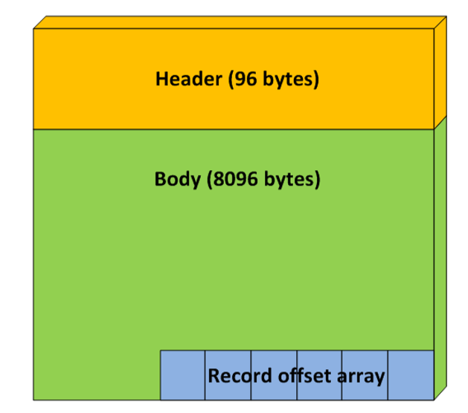
Structure of Page

Slide 11
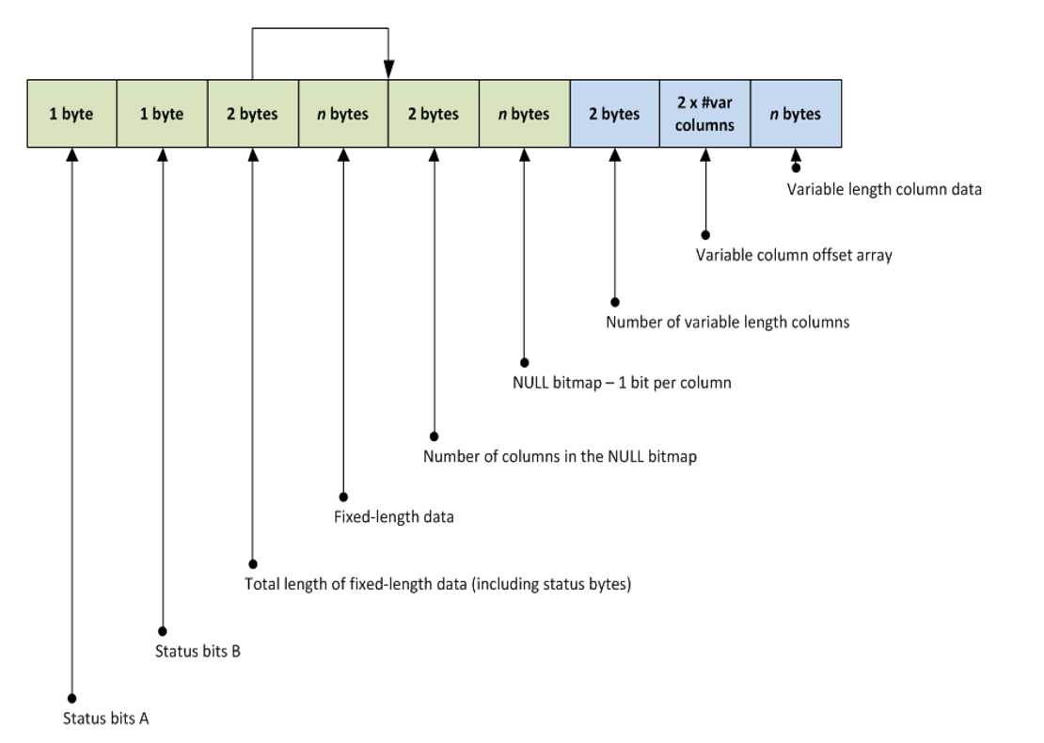
Page Structure at Byte Level
Data Record
Notes:
http://improve.dk/deciphering-a-sql-server-data-page/
http://aboutsqlserver.com/2013/10/15/sql-server-storage-engine-data-pages-and-data-rows/

Slide 12
Tools of Choice
Hex Editors
DBCC CHECKDB
fn_dblog
DBCC PAGE
DBCC IND
sys.system_internals_partition_columns
sys.fn_PhysLocFormatter
Notes:
Trace Flags: 3604

Slide 13
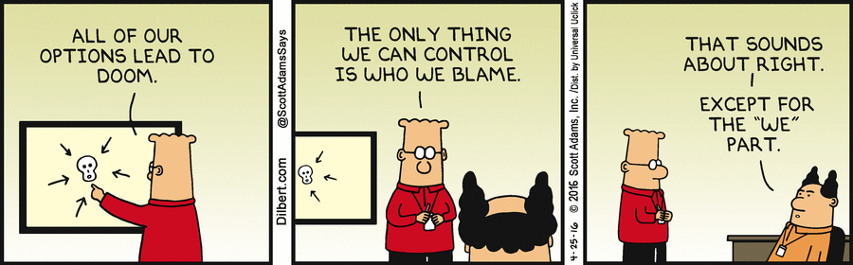
Aim is to avoid this Scenario
Notes:
First requirement is: Don’t make things worse

Slide 14
CORRUPTION DEMOS

Slide 15
In Summary
Take Backups (and test them ☺)
Monitor for Corruption
Checksum is your Friend
Practice fixing corruption.
Don’t Panic !
For more information see Resources pages

Slide 16
Resources
Steve Stedman Corruption Challenge
http://stevestedman.com/category/corruption
SQL Skills – Paul S Randal
http://www.sqlskills.com/blogs/paul/category/checkdb-from-every-angle
SQLSoldier - Robert Davis
http://www.sqlsoldier.com/wp/tag/31daysofdisasterrecovery
Minion Software – Backups and CheckDB
http://minionware.net/backup
http://minionware.net/checkdb

Slide 17
Resources cont.
ORCA MDF – Mark S Rasmussen
http://improve.dk/category/SQL%20Server%20-%20OrcaMDF/
Hex Editors
http://xvi32.en.softonic.com/download
https://mh-nexus.de/en/hxd/
Pluralsight
SQL Server: Detecting and Correcting Database Corruption
SQL Server: Detecting and Recovering from Database Corruption

